Slide 1
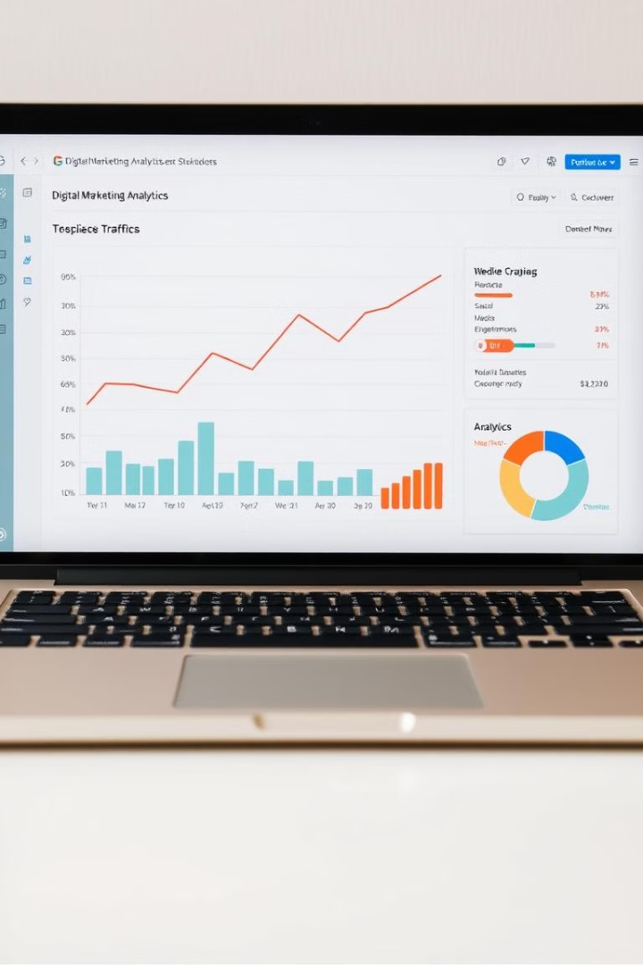
Ad Click Prediction
Project
In the digital age, the need for accurate and targeted advertising has never been greater. This presentation explores how machine learning can be leveraged to develop predictive models and drive more effective advertising campaigns.
MADE BY -
ABHISHEK JAIN (E23CSEU0265)
ANSH PANWAR (E23CSEU0256)
DEV THUKRAL (E23CSEU0258)

Slide 2
The Need for Targeted Advertising
Inefficient Traditional Ads
Personalized Experiences
Competitive Landscape
Conventional advertising often wastes valuable resources by reaching irrelevant audiences, resulting in low click-through and conversion rates.
Consumers expect personalized and relevant ads that cater to their unique interests and behaviors.
Businesses must leverage data-driven insights to stay ahead of the competition and maximize the impact of their advertising budgets.

Slide 3
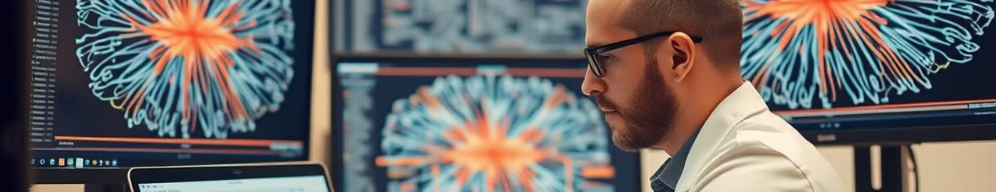
Objectives
1
Develop a Machine Learning Model
2
Enhance Targeting Capabilities
3
Optimize Advertising Spend
Create a predictive model to accurately forecast ad click-through rates.
Leverage the model to deliver more personalized and effective ad campaigns.
Improve the return on investment (ROI) of advertising budgets.

Slide 4
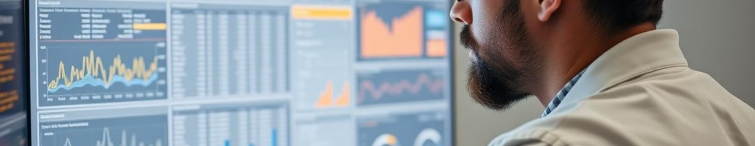
Dataset Overview
Features
Target Variable
Size and Complexity
The dataset includes user demographics, browsing history, device information, and ad campaign details.
The goal is to predict the binary outcome of whether a user will click on an ad or not.
The dataset contains millions of records, posing a significant challenge for model training and deployment.

Slide 5

Methodology
1
Data Preprocessing
Clean, normalize, and handle missing values in the dataset.
2
Feature Engineering
Create new features from the raw data to improve the model's predictive power.
3
Model Training
Test and compare various machine learning algorithms, including logistic regression and random forests.

Slide 6
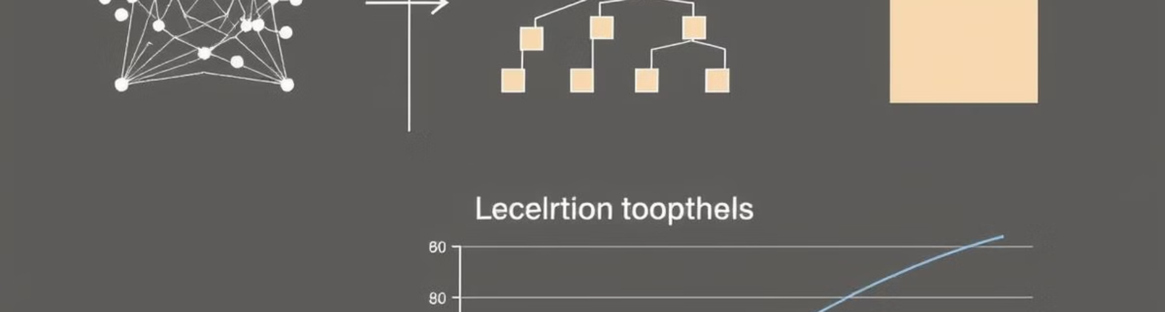



Machine Learning Models
Logistic Regression
Random Forests
Neural Networks
A classic and interpretable model for binary classification tasks.
An ensemble method that combines multiple decision trees to improve accuracy and robustness.
Deep learning models that can capture complex non-linear relationships in the data.

Slide 7
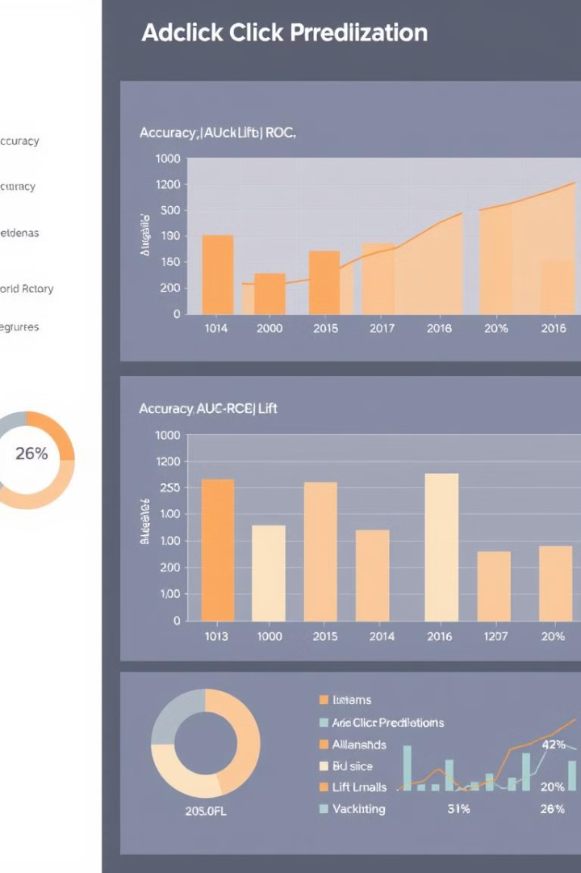
Experimental Results
85%
Accuracy
The random forest model achieved the highest accuracy in predicting ad click-through rates.
0.78
AUC-ROC
The area under the receiver operating characteristic curve, a key metric for evaluating model performance.
20%
Lift
The increase in click-through rate compared to a random ad placement strategy.

Slide 8
Web Application Functionality
User Interface
Model Integration
Reporting and Analytics
The web app provides an intuitive interface for users to input ad campaign details and obtain click-through rate predictions.
The trained machine learning model is seamlessly integrated into the web application, enabling real-time predictions.
The app offers comprehensive reporting and analytics features to help marketers optimize their advertising strategies.

Slide 9

Future Scope
Expand Data Sources
Personalized Recommendations
Incorporate additional data sources, such as social media and customer engagement metrics, to further enhance the model's predictive capabilities.
Leverage the model to provide personalized ad recommendations based on user preferences and behavior.
Real-time Optimization
Develop a system to continuously monitor and update the model, enabling real-time optimization of ad campaigns.

Slide 10

Conclusion
Key Takeaways
Real-world Impact
Machine learning can significantly improve the accuracy and targeting of digital advertising campaigns, leading to better ROI and customer engagement.
The ad click prediction model developed in this project has the potential to revolutionize how businesses approach digital marketing, ultimately driving greater success and growth.
Next Steps
Continuous model refinement, data integration, and personalized recommendations will be the focus of future development to further enhance the solution.

